Slide 1

IndabaX Malawi
22 July 2021
MUBAS
Marc Henrion
Statistical Support Unit, MLW
Biostatistics Associate Research Group, MLW
Clinical Sciences, LSTM
Statistics & Machine Learning
mhenrion@mlw.mw
www.marchenrion.com

Slide 2
Resources
Slides & R code:
https://github.com/gitMarcH/IndabaX_2021

Slide 3
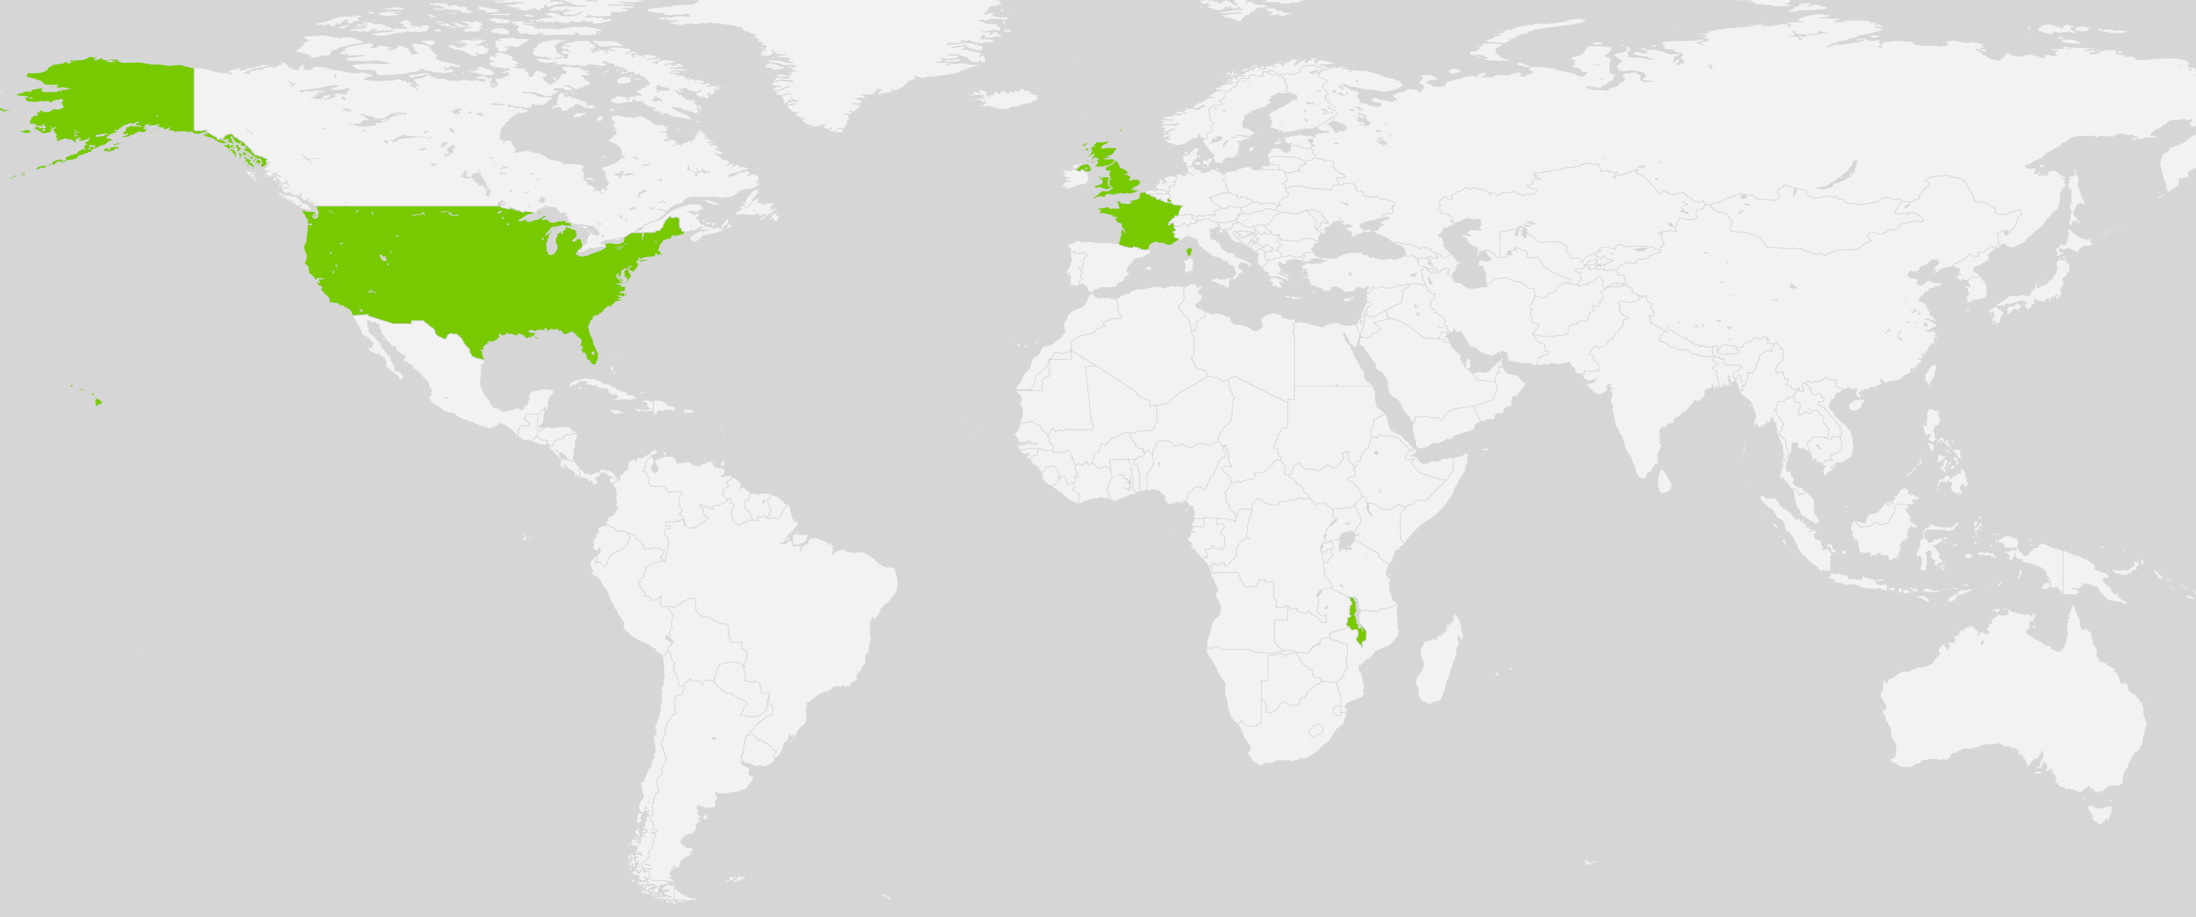






Background
Lead the Statistical Support Unit at MLW.
Raised in Luxembourg.
MSc in Mathematics.
PhD in statistical pattern recognition for digital sky surveys.
Post-docs in genetic epidemiology & multi-scale modelling.
Raised in Luxembourg
MSci, PhD @ Imperial College London & ENS Lyon
Postdoc @ ICR
Postdoc @ MSSM
Lead Statistical Support Unit @ MLW

Slide 4
Artificial intelligence, machine learning, data mining

Slide 5
Artificial intelligence
Artificial general intelligence Ability of a machine to represent the human mind and perform any human intellectual task.
Artificial narrow intelligence Ability of a machine to perform a single or a few well-defined intellectual tasks extremely well.

Slide 6
Artificial intelligence
Machine learning Often used interchangeably with AI (technically a sub-discipline).
Expert systems Requires (i) knowledge base and (ii) reasoning engine
Natural language processing
Automated planning & scheduling
…

Slide 7
Machine learning
Given a set of training data vectors {x₁, ..., x_{n}}, learn / tune / estimate a certain parameter of an adaptive model M.
Focus is on how to instruct a computer to do this task.
“The field of machine learning is concerned with the question of how to construct computer programs that automatically improve with experience.”
Mitchell, T.M., Machine Learning, McGraw-Hill, 1997
In practice, the goal is usually prediction.

Slide 8
Machine learning - types
Supervised
Classification
Regression
Unsupervised
Clustering
Density estimation
Visualisation
Data mining
Reinforcement learning

Slide 9
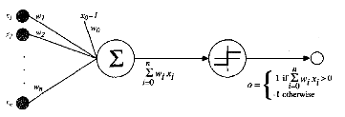
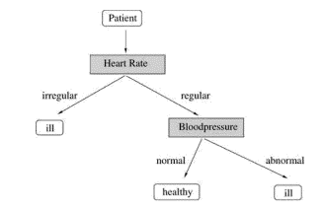
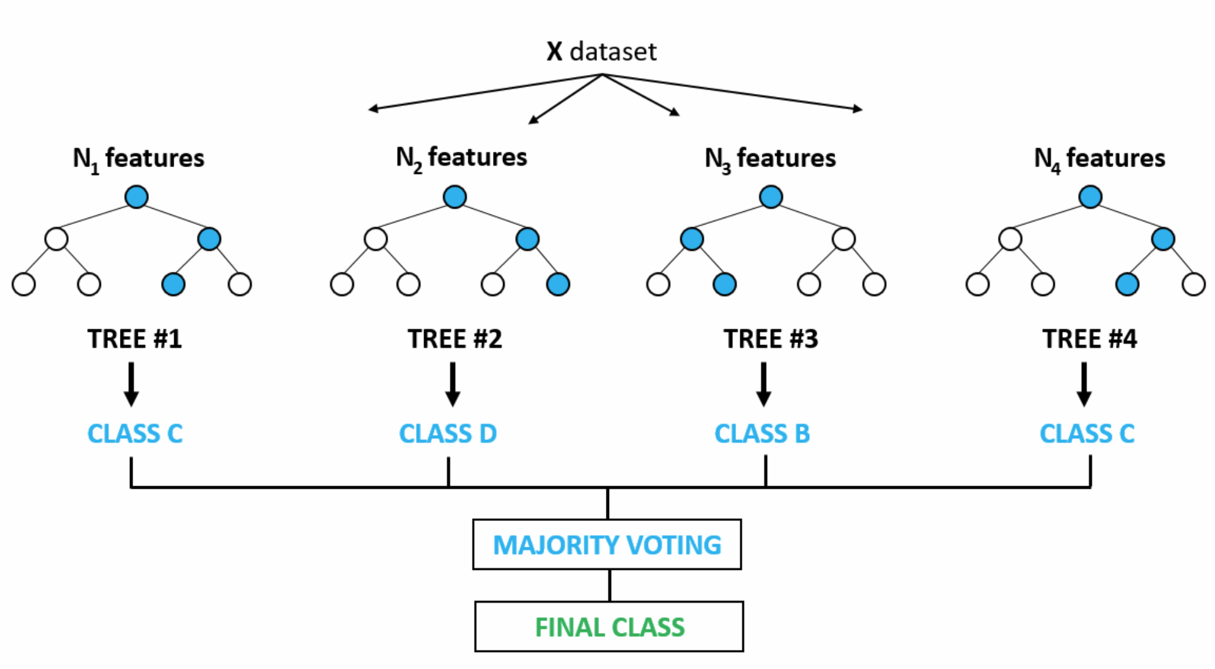
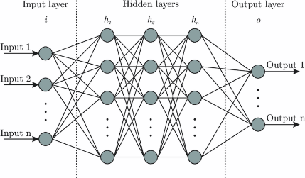
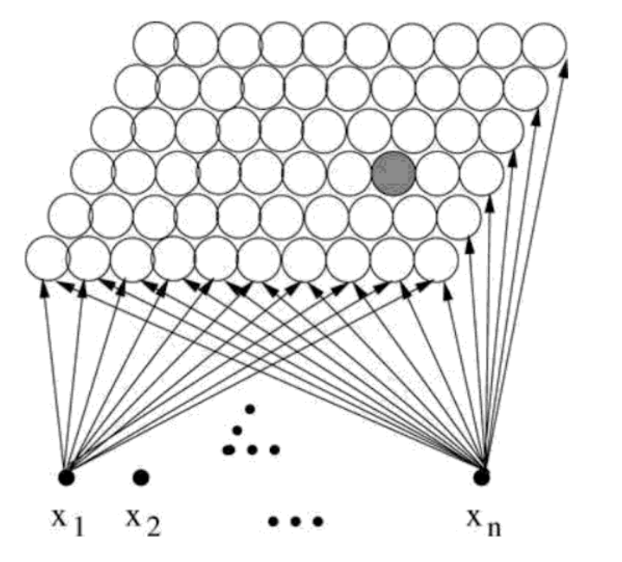
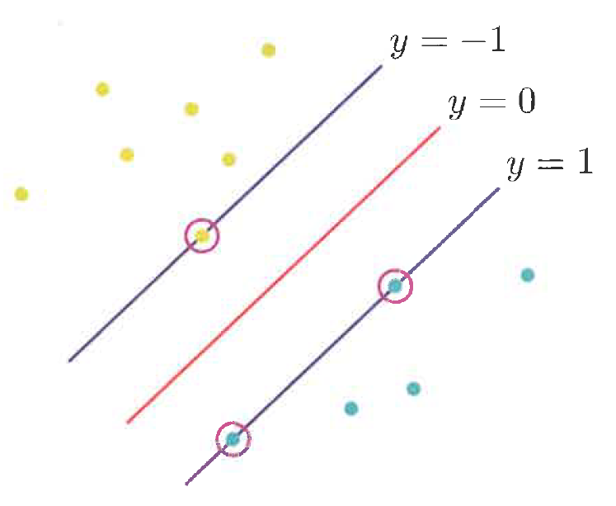
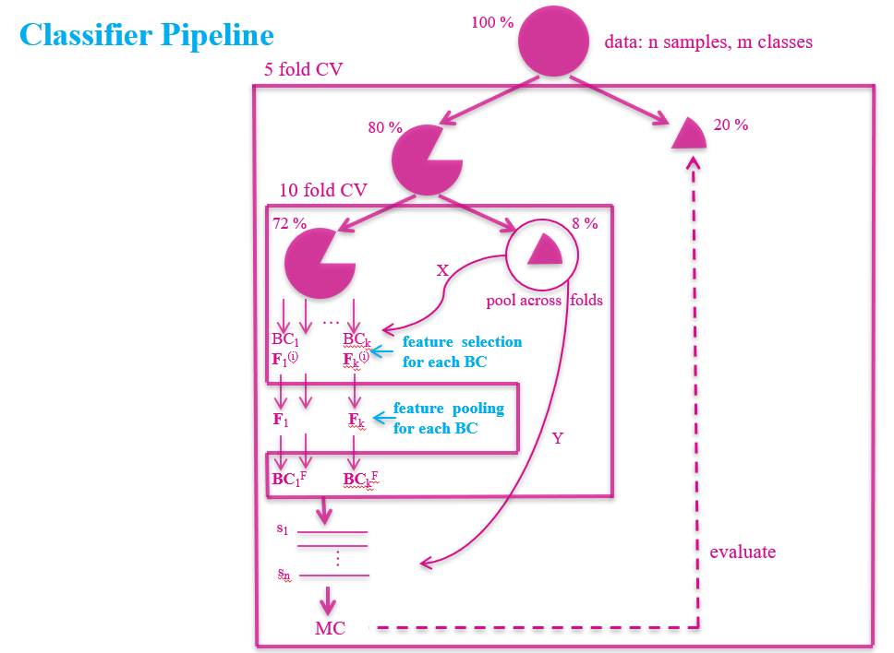
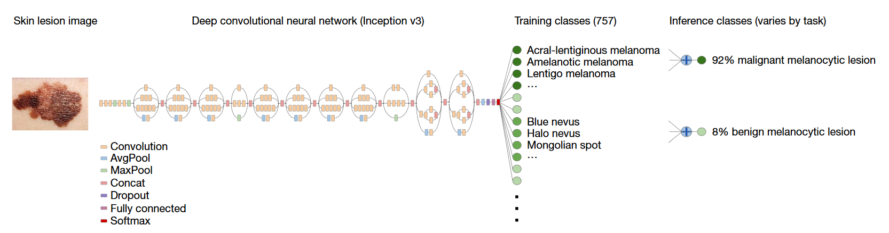
Machine learning - algorithms
Decision trees & random forests
Support vector machines
Ensemble learners
Neural networks
Artificial neuron
Multilayer perceptrons
Self-organising maps
Deep learning
Mitchell, T.M. (1997), Machine Learning, McGraw-Hill
Van den Eijkel, G. (2007), Intelligent Data Analysis, 2nd ed., Berthold M., Hand, D.J., (eds.), Springer
globalsoftwaresupport.com
Bre et al. (2017), 10.1016/j.enbuild.2017.11.045
Silipo, R. (2007), Intelligent Data Analysis, 2nd ed., Berthold M., Hand, D.J., (eds.), Springer
Bishop, C. (2007), Pattern Recognition and Machine Learning, Springer
Henrion et al., unpublished
Esteva et al. (2017), 10.1038/nature21056

Slide 10
… & statistics?

Slide 11
Statistics
“When you’re fundraising, it’s AI.
When you’re hiring, it’s ML.
When you’re implementing, it’s logistic regression.”
The internet.

Slide 12
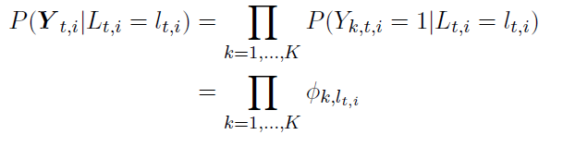
Machine learning - algorithms
Statistical models
Decision trees & random forests
Support vector machines
Ensemble learners
Neural networks
Artificial neuron
Multilayer perceptrons
Self-organising maps
Deep learning
Mitchell, T.M. (1997), Machine Learning, McGraw-Hill
Van den Eijkel, G. (2007), Intelligent Data Analysis, 2nd ed., Berthold M., Hand, D.J., (eds.), Springer
globalsoftwaresupport.com
Bre et al. (2017), 10.1016/j.enbuild.2017.11.045
Silipo, R. (2007), Intelligent Data Analysis, 2nd ed., Berthold M., Hand, D.J., (eds.), Springer
Bishop, C. (2007), Pattern Recognition and Machine Learning, Springer
Henrion et al., unpublished
Esteva et al. (2017), 10.1038/nature21056

Slide 13
Statistics
A lot of ML algorithms developed outside the context of statistical science.
Many are heuristics – i.e. practical, not necessarily optimal.
Statisticians interested in knowing asymptotic properties of methods:
Given infinite amounts of data, are you actually going to get the right solution?
If not, by how far are you off?
How precise will your estimate be?
Estimated parameters have statistical properties: bias, variance, …
Much (most?) of statistics is about minimising the bias-variance trade-off.
In other words:
While an algorithm may work on a particular dataset, will it work in general with any dataset?

Slide 14
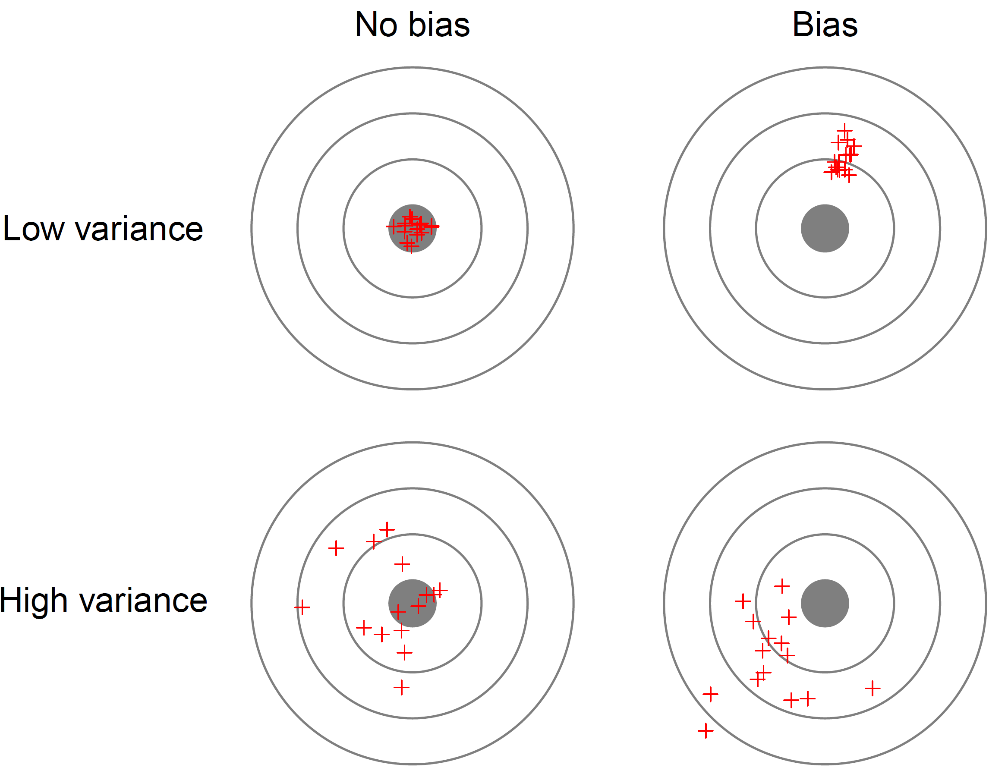
Statistics – bias-variance trade-off

Slide 15
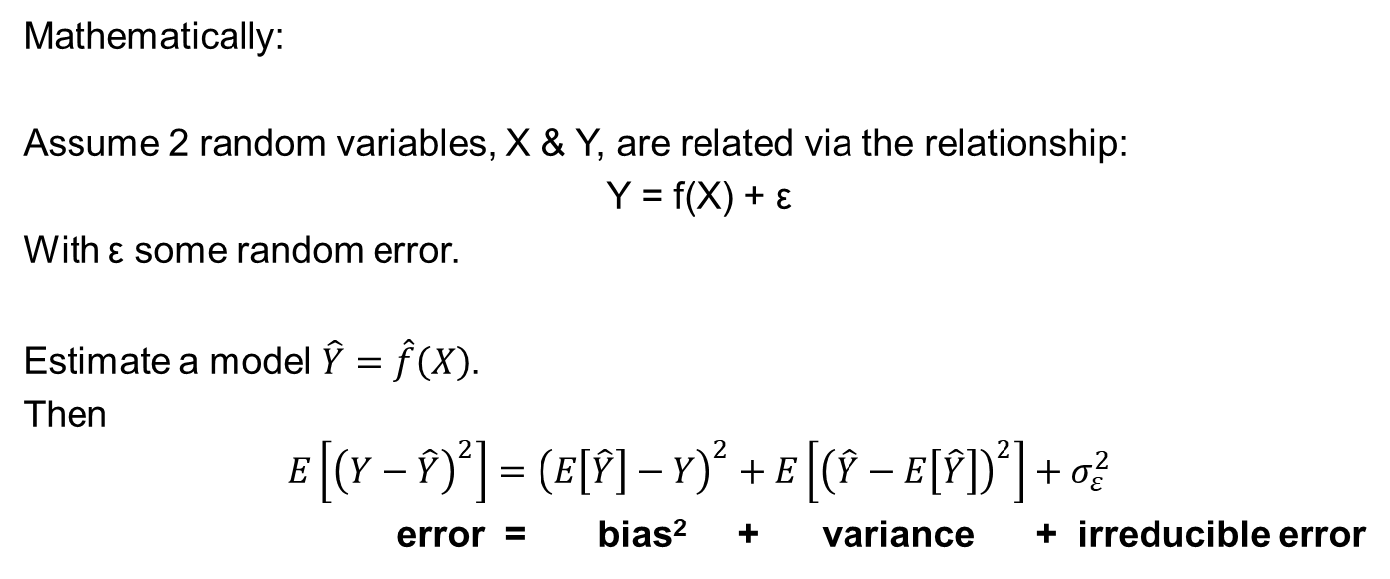
Statistics – bias-variance trade-off
Mathematically:
Assume 2 random variables, X & Y, are related via the relationship:
Y = f(X) + ε
With ε some random error.
Estimate a model $\hat{Y}=\hat{f}\left(X\right)$.
Then
$$E\left[{\left(Y−\hat{Y}\right)}^{2}\right]={\left(E\left[\hat{Y}\right]−Y\right)}^{2}+E\left[{\left(\hat{Y}−E\left[\hat{Y}\right]\right)}^{2}\right]+σ_{ε}^{2}$$
error = bias² + variance + irreducible error

Slide 16
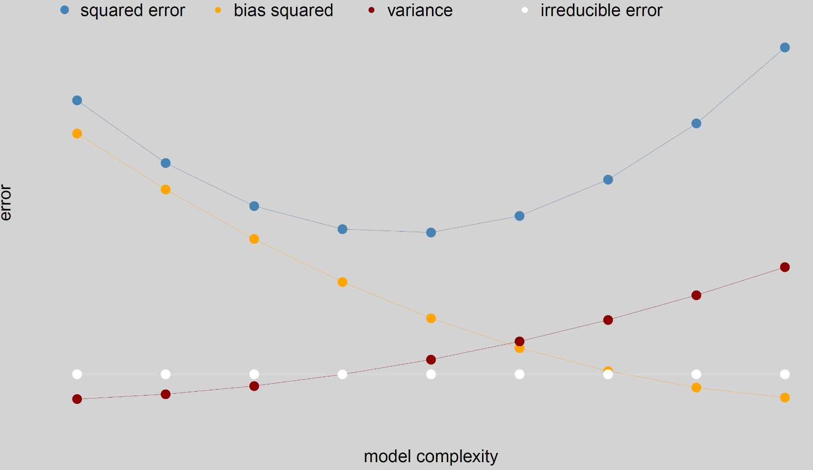
Statistics – bias-variance trade-off

Slide 17
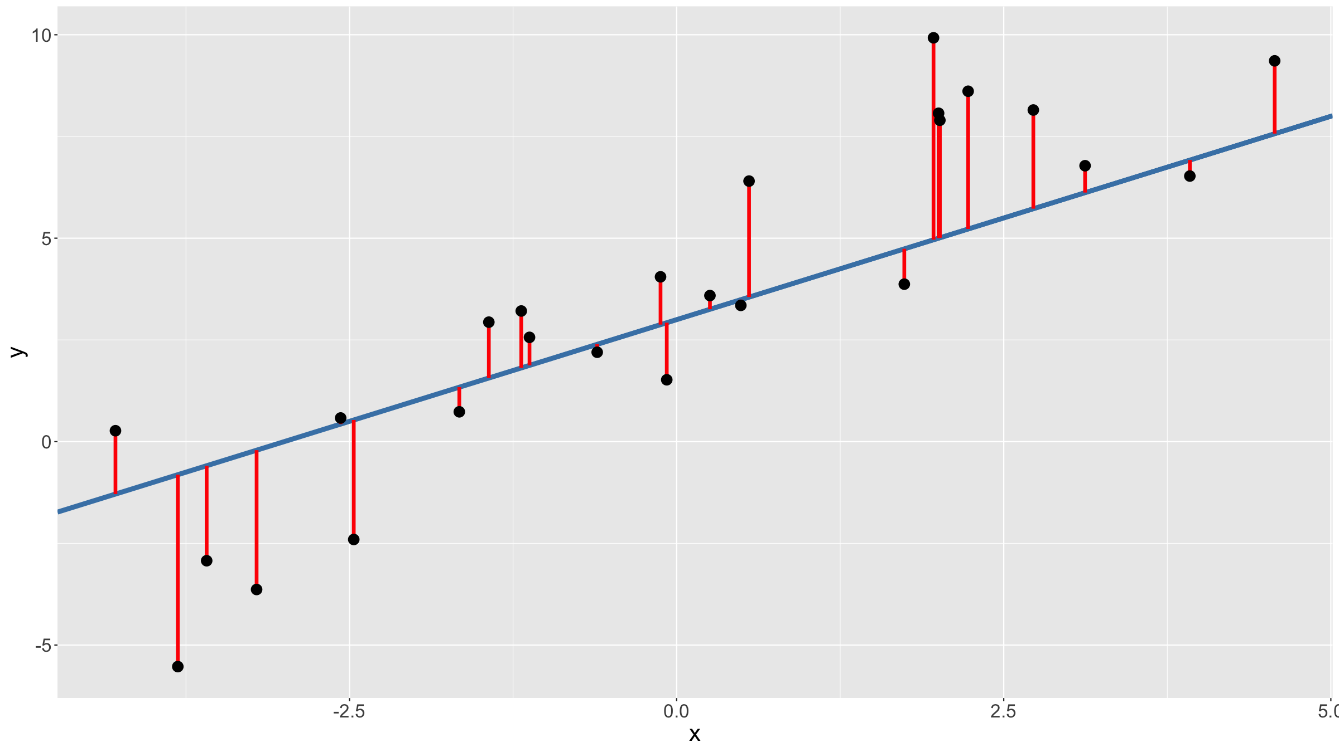
Statistics – SS as an error function for optimisation

Slide 18
Statistics
Sum of squares is the most common error function because it leads to a convex optimisation problem.
Statisticians tend not to optimise the sum of squared errors (least squares - LS), but rather maximise the likelihood (maximum likelihood - ML) of observing a given dataset assuming a given model. This is a more general approach, though it does make additional assumptions.
For many models, ML & LS are equivalent, for some they are not (e.g. non-normal errors in linear model).
In machine learning, usually predictive error / accuracy is optimised (using, e.g. cross-validation).
Notes:
Note: ROC & AUC for binary classification problems

Slide 19
Statistics
Test set performance:
Consider not only how well a model fits the current dataset, but also how well it will perform on future data.
But this comes at a cost:
Not all the data is used to estimate the model parameters.
What should the focus be: inference or prediction?

Slide 20
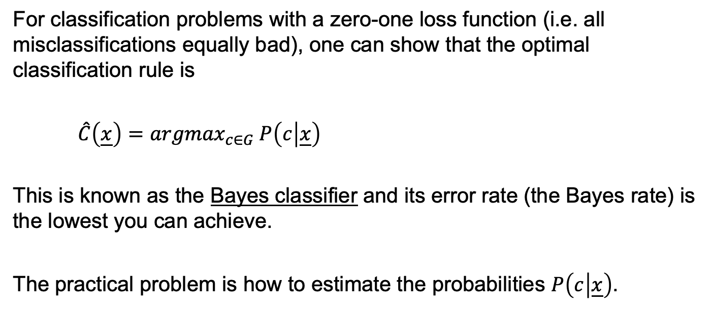
Statistical decision theory
For classification problems with a zero-one loss function (i.e. all misclassifications equally bad), one can show that the optimal classification rule is
$\hat{C}\left(\underline{x}\right)={argmax}_{c∈G} P\left(c | \underline{x}\right)$
This is known as the Bayes classifier and its error rate (the Bayes rate) is the lowest you can achieve.
The practical problem is how to estimate the probabilities $P\left(c | \underline{x}\right)$.

Slide 21
An overly broad generalisation…
Statistics
Focus on statistical inference about model parameters.
Do these 2 groups have different mean values?
Is this slope coefficient different from 0?
Great for small to medium large datasets (in numbers of variables).
Great for interpretability.
Makes substantial assumptions about data generating mechanism.

Slide 22
An overly broad generalisation…
Machine learning
Focus on prediction.
What is the most likely type of an object, given an image of it?
What is the most likely successful advert to display to a user?
Great for large, complex datasets.
Great for automation.
Great if little is known about data generating mechanism.

Slide 23
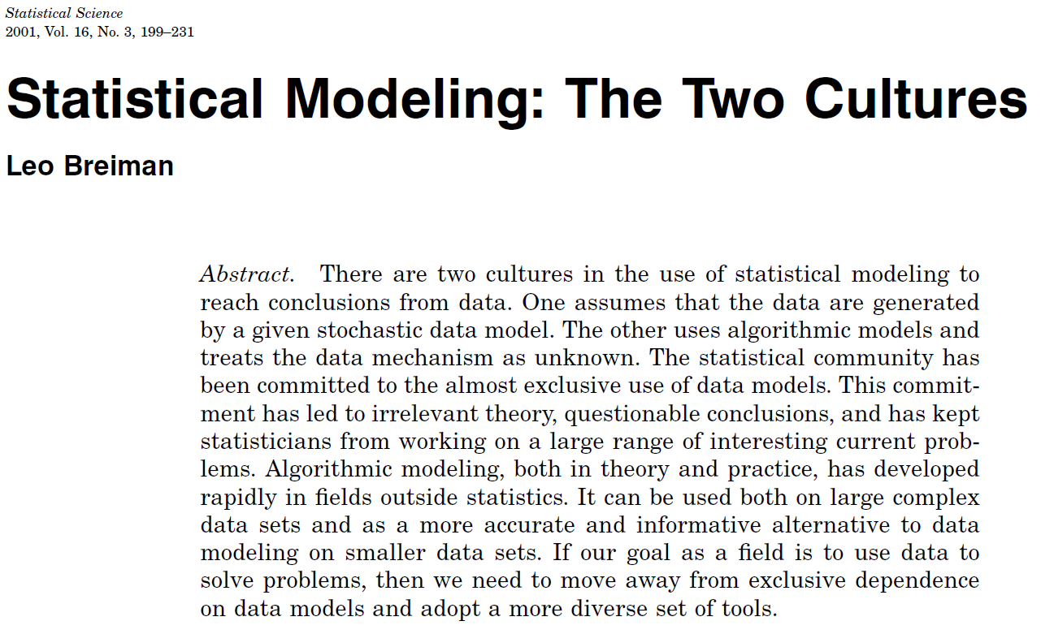
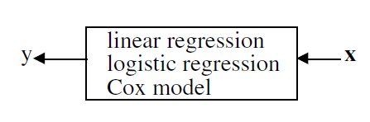
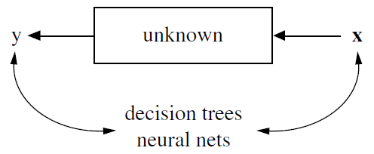
An overly broad generalisation…

Slide 24
Reasoning under uncertainty
PROBABILITY
To quantify uncertainty, we need to use the tools of probability theory.
STATISTICS
To gain insights from observational data we need to make statistical inference.
MACHINE LEARNING
Use mathematical, statistical & computational tools to make predictions.

Slide 25
Statistics & machine learning
Apart from machine learning being based on statistical principles, statistics also plays a role in:
Preparing / cleaning data
Algorithm / model selection
Evaluating algorithm / model performance
Deriving properties of estimated parameters (e.g. confidence intervals)
…

Slide 26
Terminology / history

Slide 27
Mathematics →
Computer science →
Engineering →
Statistics
Machine learning
Pattern recognition

Slide 28
Equivalent terminology & models
Statistics ↔
models ↔
parameters ↔
fitting / estimating ↔
test set performance ↔
logistic regression ≈
Machine learning
networks, graphs
weights
learning
generalisation
perceptron

Slide 29
12 key (statistical) techniques for data scientists

Slide 30
Key modelling techniques
GLM: linear, log-linear, logistic, Poisson, …
Splines & GAM
Regularisation: lasso, ridge, elastic net
Simple classification / clustering: k-nearest neighbour, k-means
Kernel density estimation & classification
Mixture models & the EM algorithm
LDA, QDA, RDA
Decision trees & random forest
Neural networks & deep learning
Graphical models
PCA & factor analysis
Bootstrap & resampling techniques

Slide 31
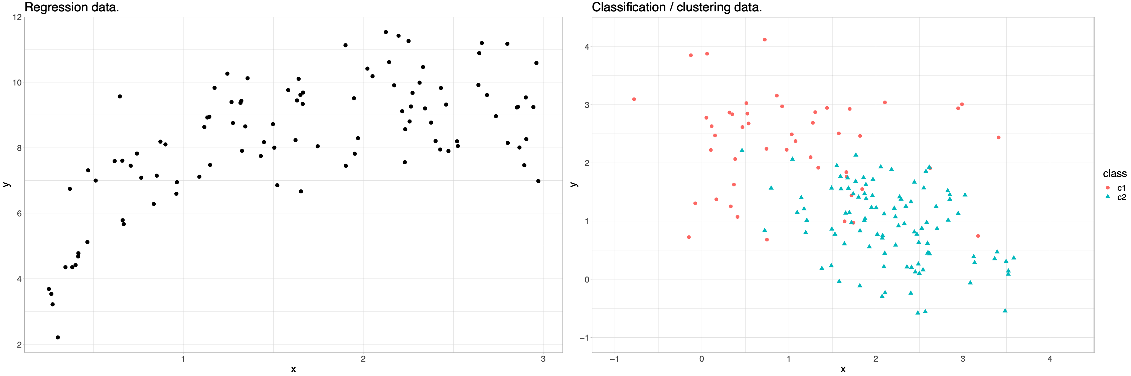
Key modelling techniques
Some example data

Slide 32
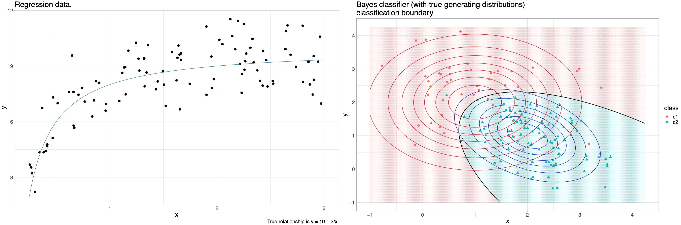
Key modelling techniques
Some example data

Slide 33
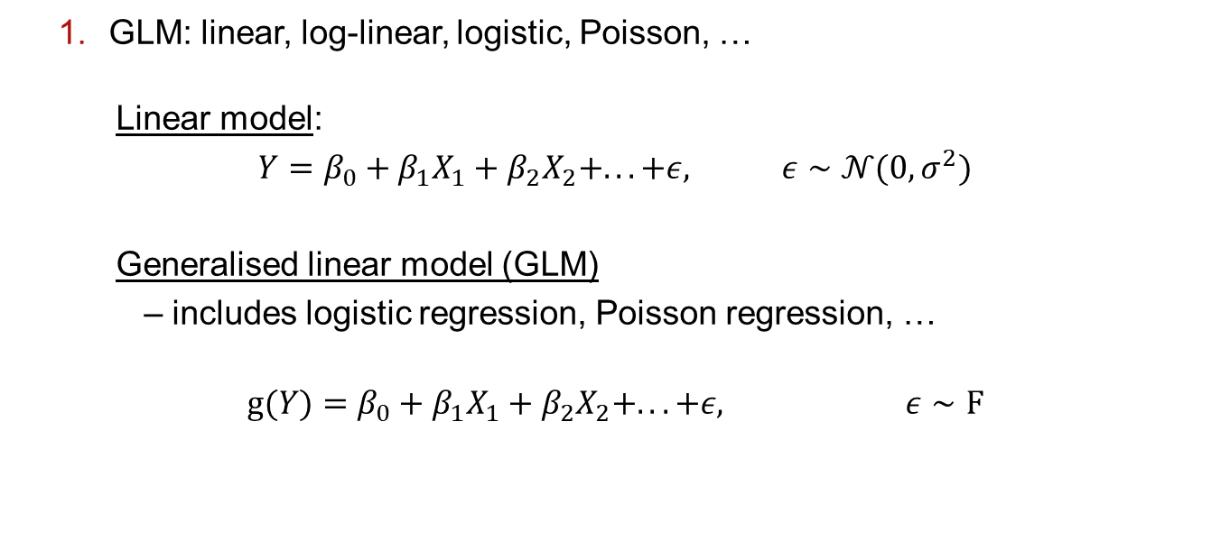
Key modelling techniques
GLM: linear, log-linear, logistic, Poisson, …
Linear model:
$Y=β_{0}+β_{1}X_{1}+β_{2}X_{2}+.. .+ε,$ $ε∼𝒩(0,σ^{2})$
Generalised linear model (GLM)
– includes logistic regression, Poisson regression, …
$g(Y)=β_{0}+β_{1}X_{1}+β_{2}X_{2}+.. .+ε,$ $ε∼F$

Slide 34
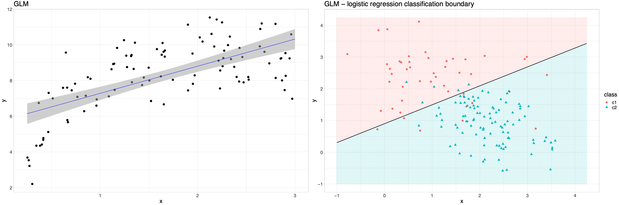
Key modelling techniques
GLM: linear, log-linear, logistic, Poisson, …

Slide 35
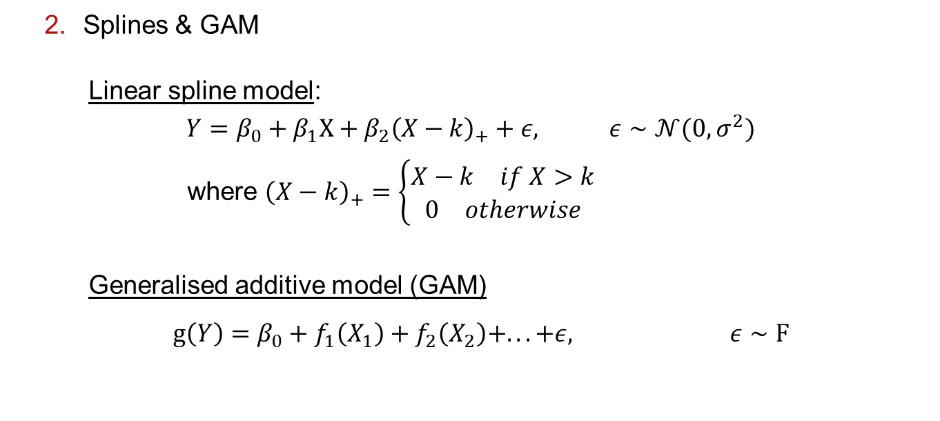
Key modelling techniques
Splines & GAM
Linear spline model:
$Y=β_{0}+β_{1}X+β_{2}{\left(X−k\right)}_{+}+ε,$ $ε∼𝒩(0,σ^{2})$
where ${\left(X−k\right)}_{+}=\left\{\begin{matrix}\begin{matrix}X−k & if X>k\end{matrix} \\ \begin{matrix}0 & otherwise\end{matrix}\end{matrix}\right.$
Generalised additive model (GAM)
$g\left(Y\right)=β_{0}+f_{1}\left(X_{1}\right)+f_{2}\left(X_{2}\right)+.. .+ε,$ $ε∼F$

Slide 36
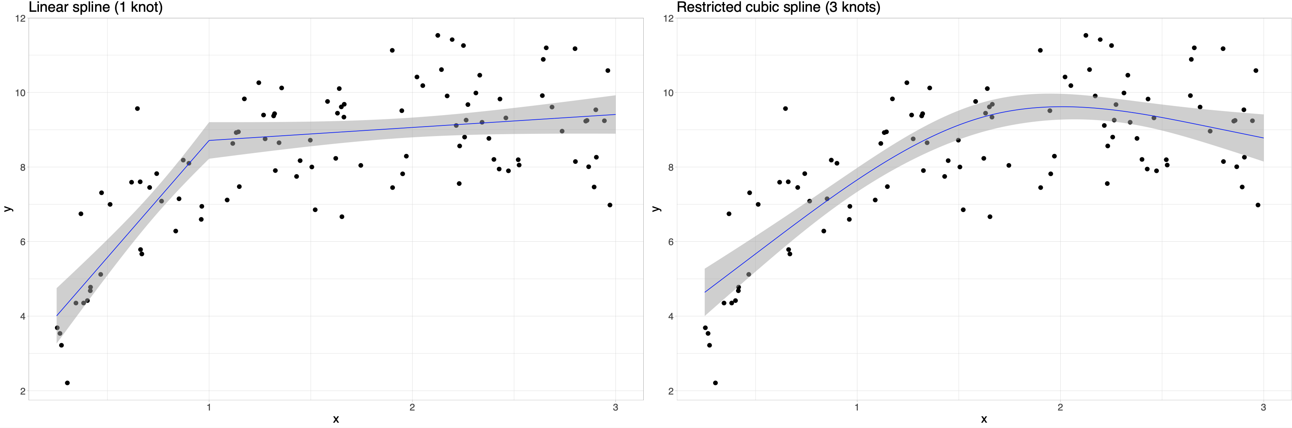
Key modelling techniques
Splines & GAM

Slide 37
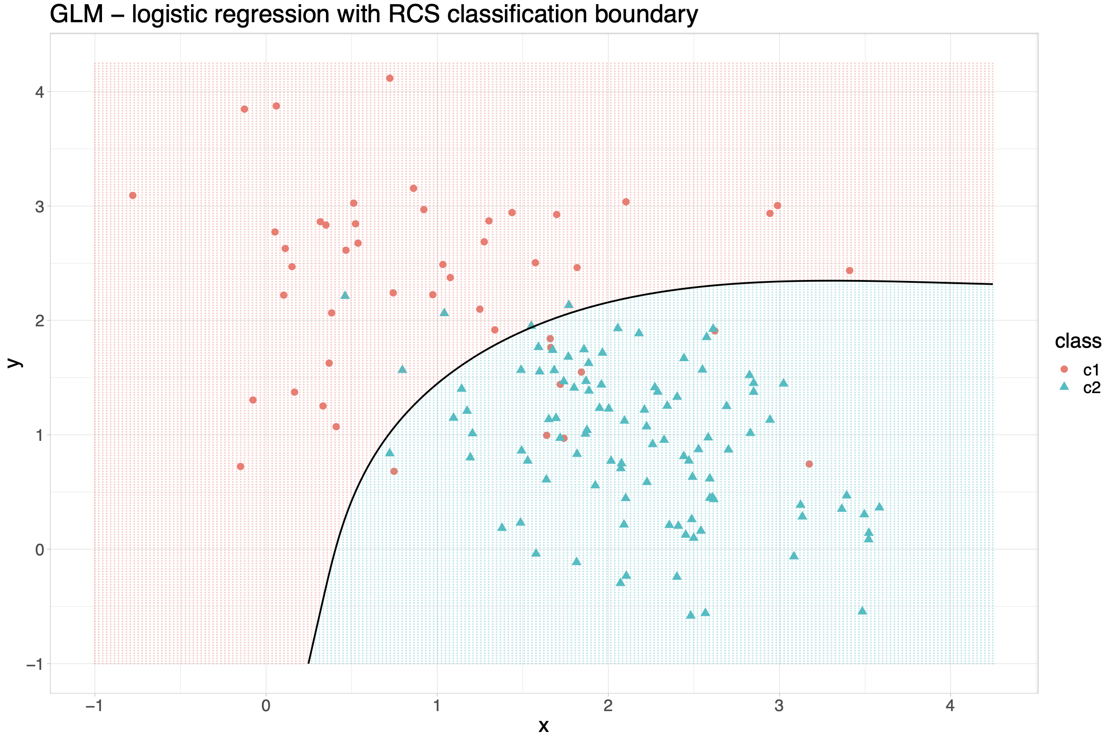
Key modelling techniques
Splines & GAM

Slide 38
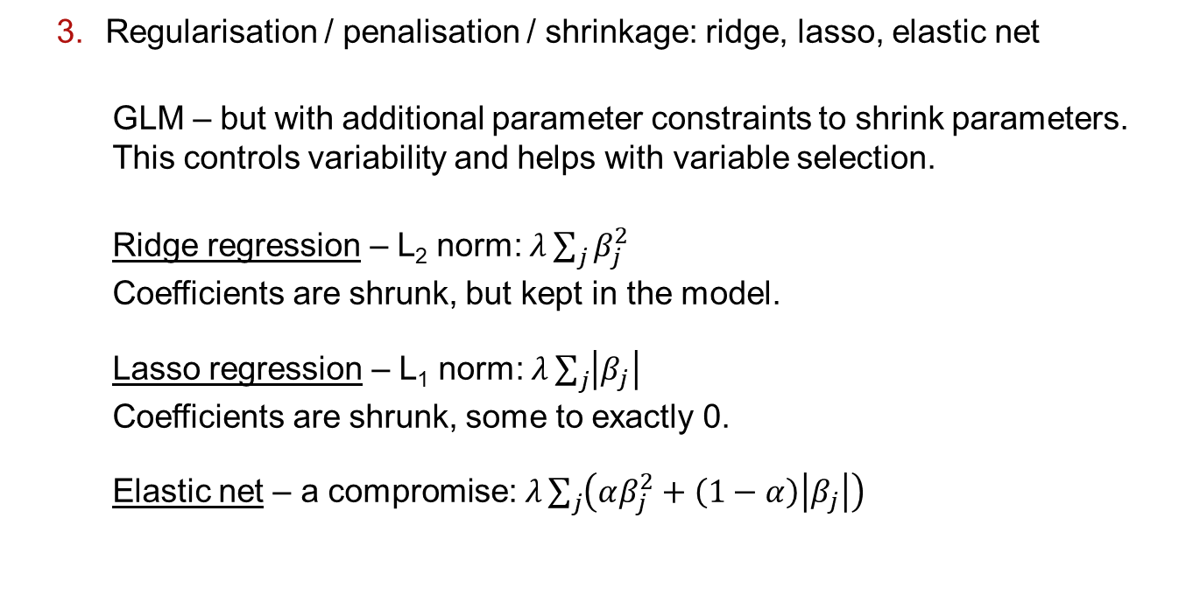
Key modelling techniques
Regularisation / penalisation / shrinkage: ridge, lasso, elastic net
GLM – but with additional parameter constraints to shrink parameters. This controls variability and helps with variable selection.
Ridge regression – L₂ norm: $λ\sum_{j}{β_{j}^{2}}$
Coefficients are shrunk, but kept in the model.
Lasso regression – L₁ norm: $λ\sum_{j}{\left|β_{j}\right|}$
Coefficients are shrunk, some to exactly 0.
Elastic net – a compromise: $λ\sum_{j}{\left(αβ_{j}^{2}+\left(1−α\right)\left|β_{j}\right|\right)}$

Slide 39
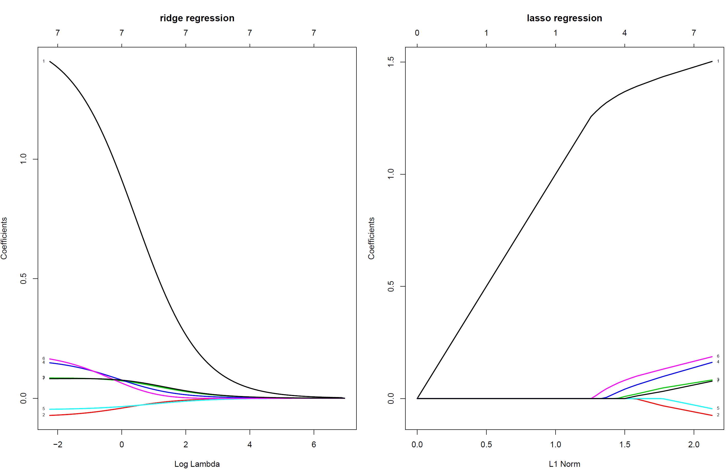
Key modelling techniques
Regularisation / penalisation / shrinkage: ridge, lasso, elastic net

Slide 40
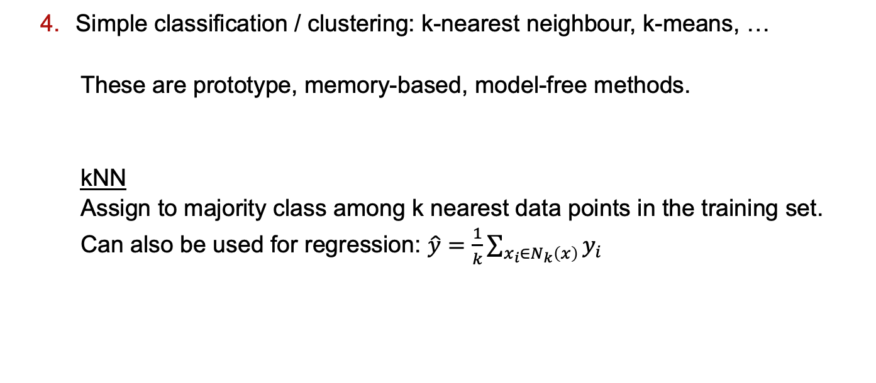
Key modelling techniques
Simple classification / clustering: k-nearest neighbour, k-means, …
These are prototype, memory-based, model-free methods.
kNN
Assign to majority class among k nearest data points in the training set.
Can also be used for regression: $\hat{y}=\frac{1}{k}\sum_{x_{i}∈N_{k}\left(x\right)}{y_{i}}$

Slide 41
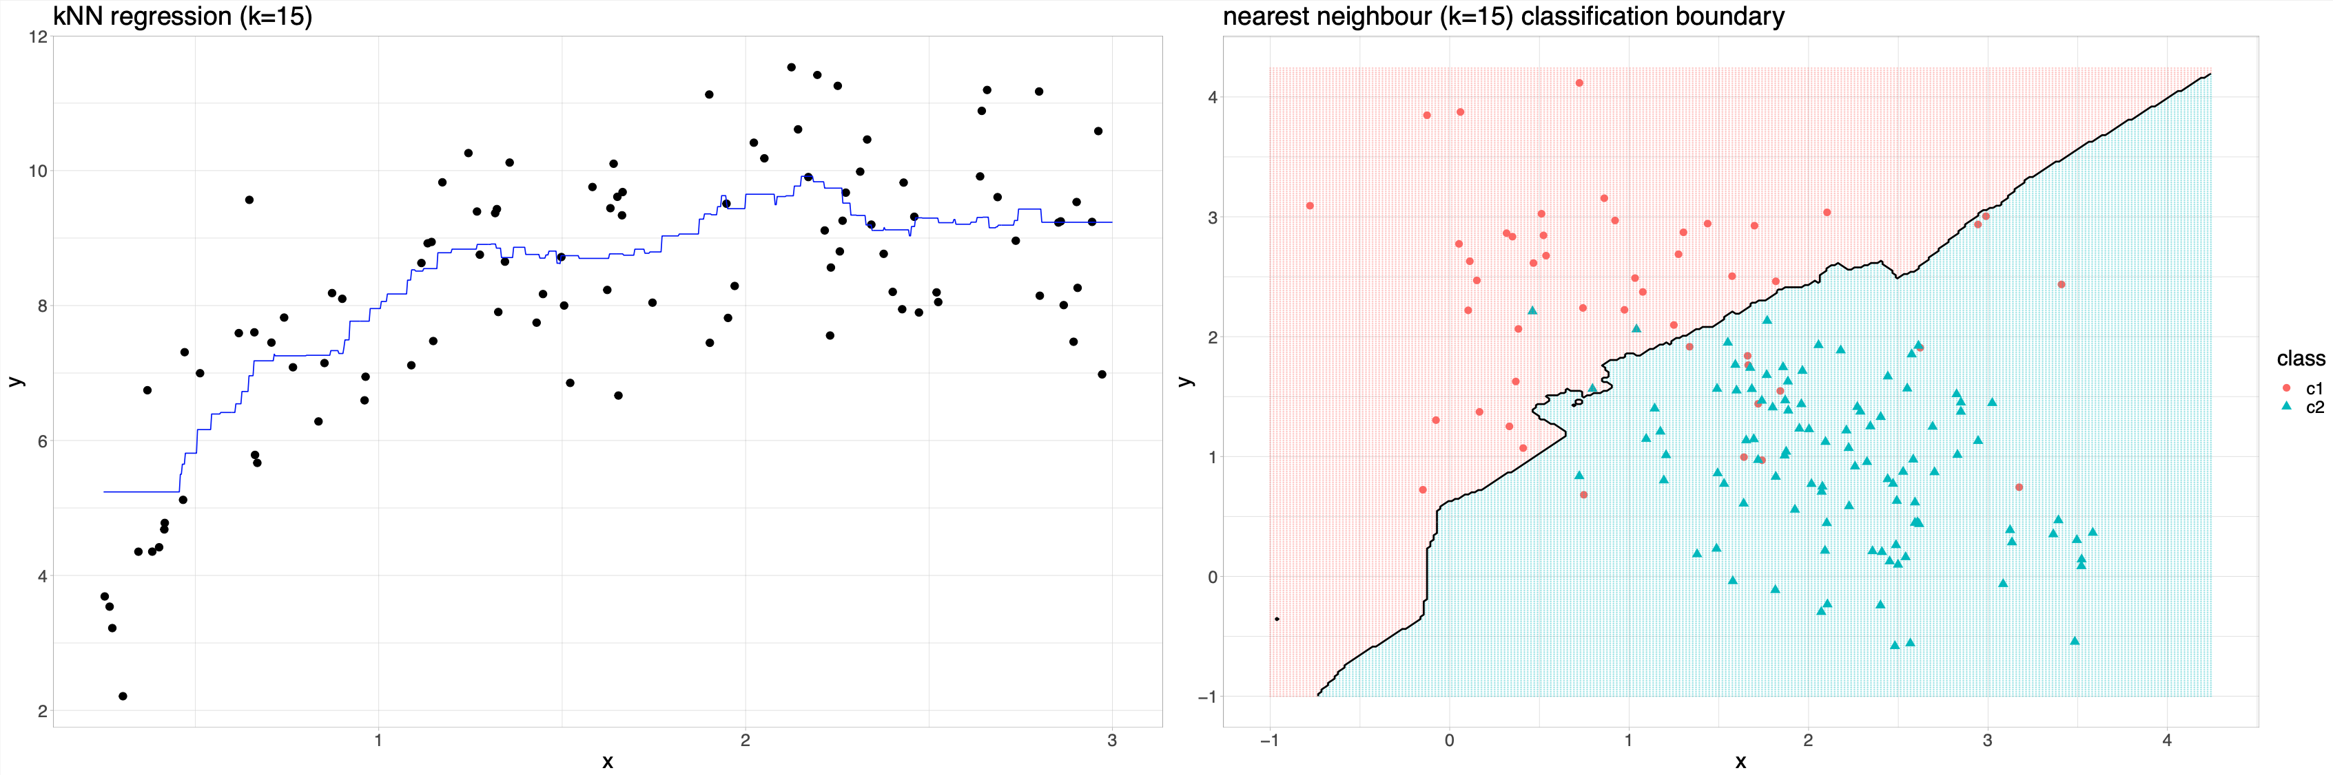
Key modelling techniques
Simple classification / clustering: k-nearest neighbour, k-means, …

Slide 42
Key modelling techniques
Simple classification / clustering: k-nearest neighbour, k-means, …
k-means
Start with a random set of initial cluster centroids.
Assign samples to nearest centroid.
Recompute centroids for each cluster.
Iterate until convergence.

Slide 43
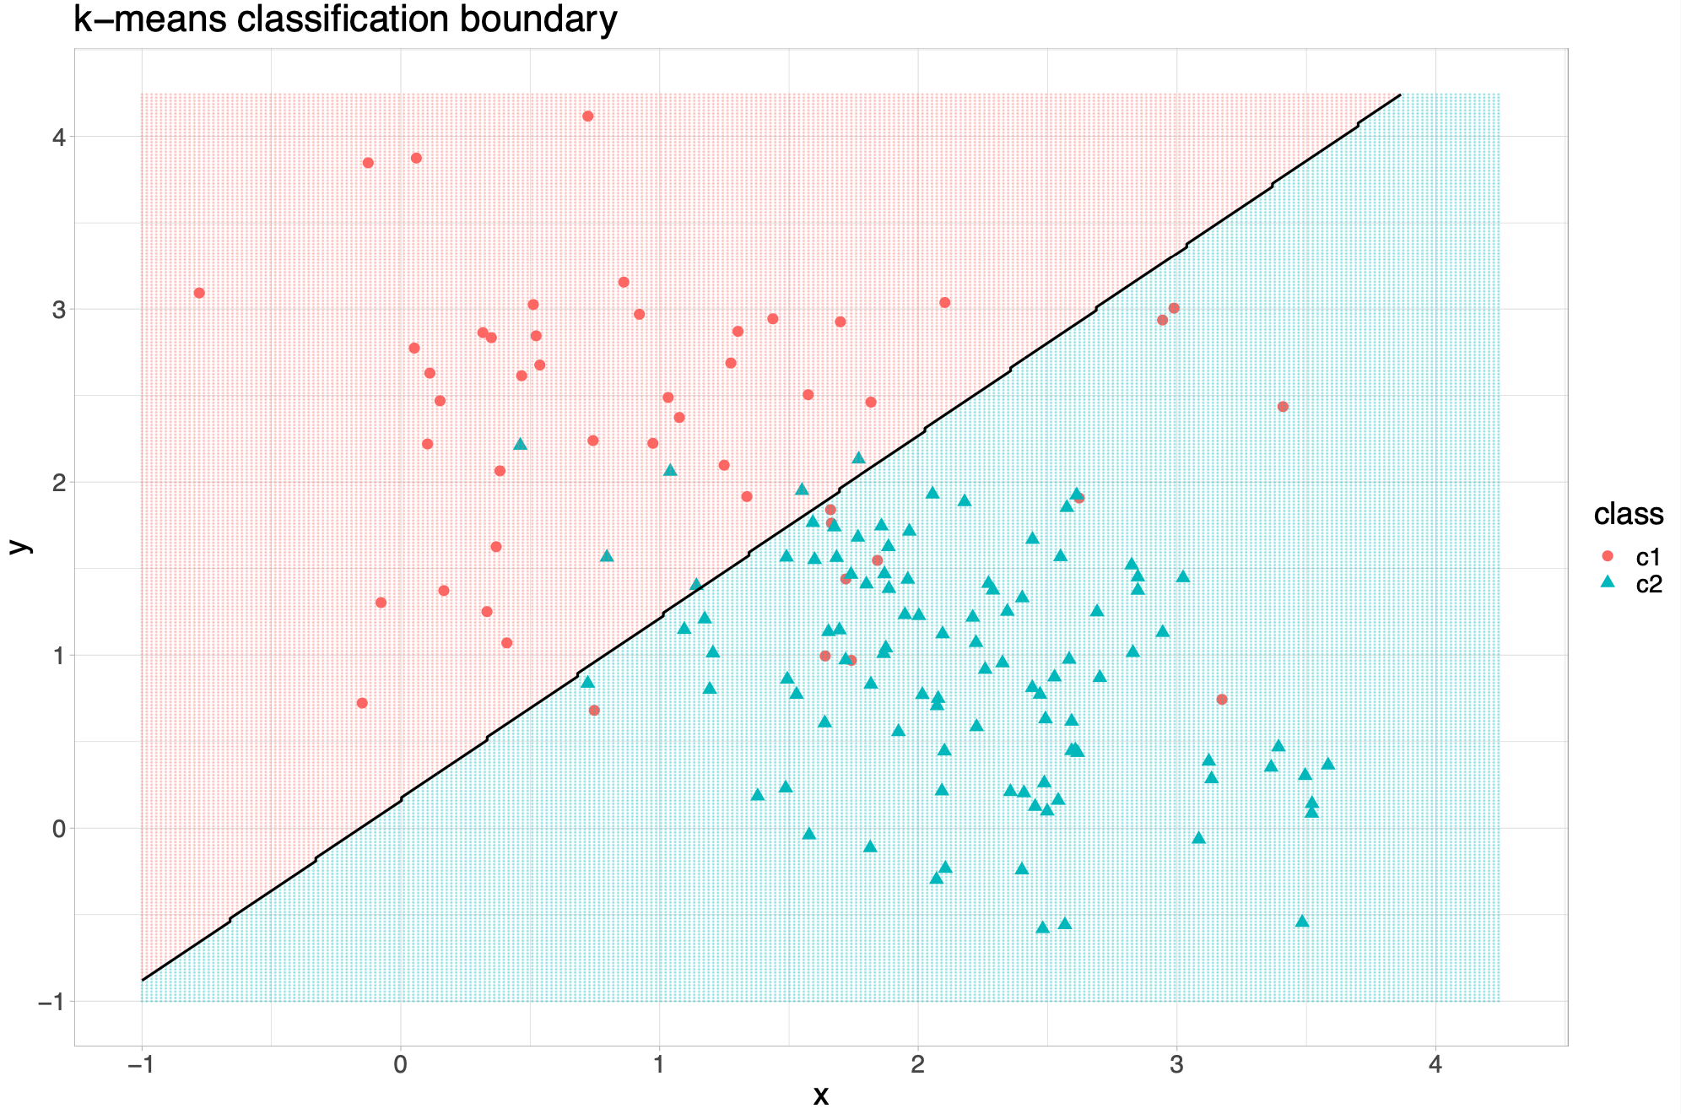
Key modelling techniques
Simple classification / clustering: k-nearest neighbour, k-means, …

Slide 44
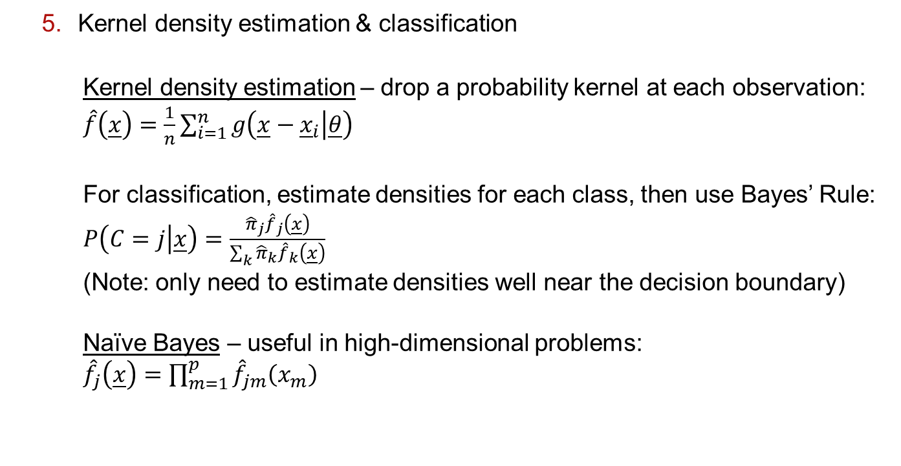
Key modelling techniques
Kernel density estimation & classification
Kernel density estimation – drop a probability kernel at each observation:
$\hat{f}\left(\underline{x}\right)=\frac{1}{n}\sum_{i=1}^{n}{g\left(\underline{x}−{\underline{x}}_{i} | \underline{θ}\right)}$
For classification, estimate densities for each class, then use Bayes’ Rule:
$P\left(C=j | \underline{x}\right)=\frac{{\hat{π}}_{j}{\hat{f}}_{j}\left(\underline{x}\right)}{\sum_{k}{{\hat{π}}_{k}{\hat{f}}_{k}\left(\underline{x}\right)}}$
(Note: only need to estimate densities well near the decision boundary)
Naïve Bayes – useful in high-dimensional problems:
${\hat{f}}_{j}\left(\underline{x}\right)=\prod_{m=1}^{p}{{\hat{f}}_{jm}\left(x_{m}\right)}$

Slide 45
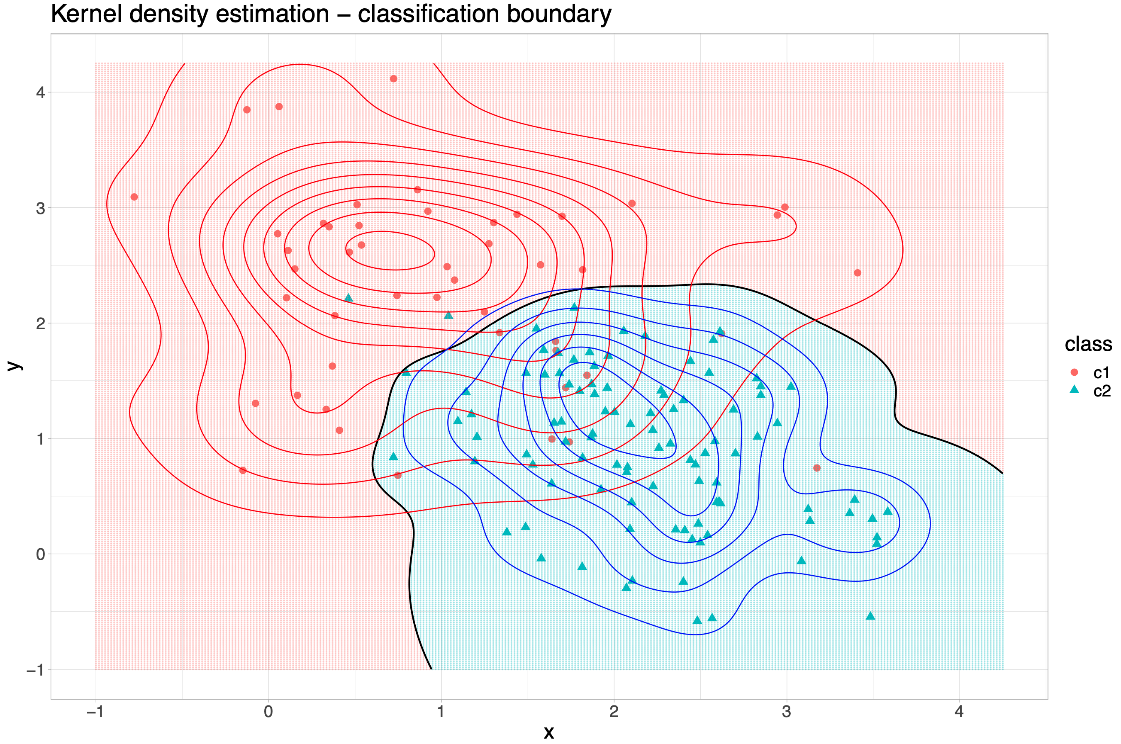
Key modelling techniques
Kernel density estimation & classification

Slide 46
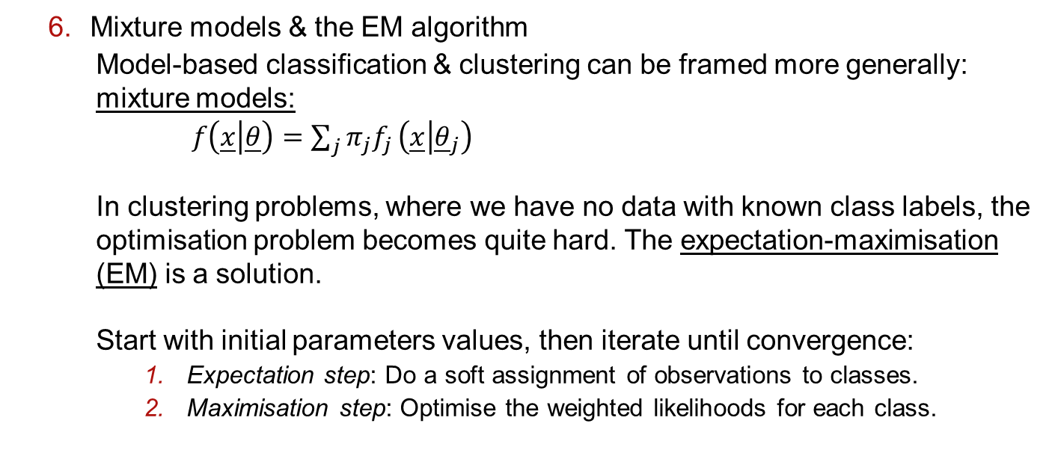
Key modelling techniques
Mixture models & the EM algorithm
Model-based classification & clustering can be framed more generally: mixture models:
$f\left(\underline{x} | \underline{θ}\right)=\sum_{j}{{π_{j}f}_{j}}\left(\underline{x} | {\underline{θ}}_{j}\right)$
In clustering problems, where we have no data with known class labels, the optimisation problem becomes quite hard. The expectation-maximisation (EM) is a solution.
Start with initial parameters values, then iterate until convergence:
Expectation step: Do a soft assignment of observations to classes.
Maximisation step: Optimise the weighted likelihoods for each class.

Slide 47
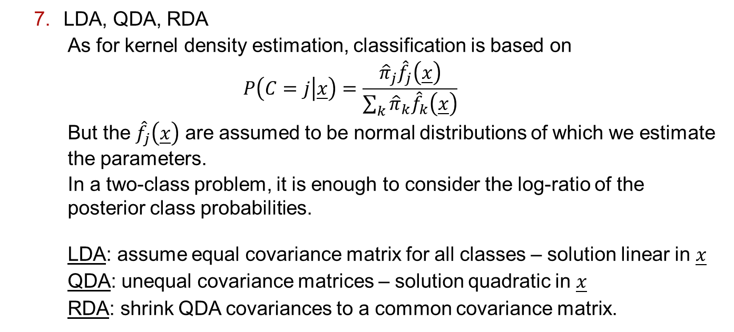
Key modelling techniques
LDA, QDA, RDA
As for kernel density estimation, classification is based on
$$P\left(C=j | \underline{x}\right)=\frac{{\hat{π}}_{j}{\hat{f}}_{j}\left(\underline{x}\right)}{\sum_{k}{{\hat{π}}_{k}{\hat{f}}_{k}\left(\underline{x}\right)}}$$
But the ${\hat{f}}_{j}\left(\underline{x}\right)$ are assumed to be normal distributions of which we estimate the parameters.
In a two-class problem, it is enough to consider the log-ratio of the posterior class probabilities.
LDA: assume equal covariance matrix for all classes – solution linear in $\underline{x}$
QDA: unequal covariance matrices – solution quadratic in $\underline{x}$
RDA: shrink QDA covariances to a common covariance matrix.

Slide 48
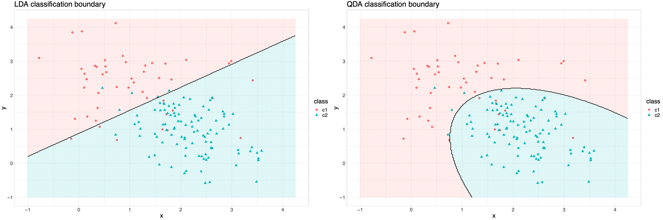
Key modelling techniques
LDA, QDA, RDA

Slide 49
Key modelling techniques
Decision trees & random forest
Decision trees aim to partition the feature space into sub-regions, with a simple model in each region:
Average value of response variable in region R_{m} (regression).
Majority class in region R_{m} (classification).
At each step the algorithm selects a variable and a split on that variable that minimizes a node impurity function.
Squared error node impurity (regression).
Misclassification rate / Gini coefficient / deviance (classification).
To avoid overfitting a cost-complexity function is optimised that penalises large trees.
Notes:
Note: this specifically describes the CART algorithm…
There are (many) other algorithms but similar principle.

Slide 50
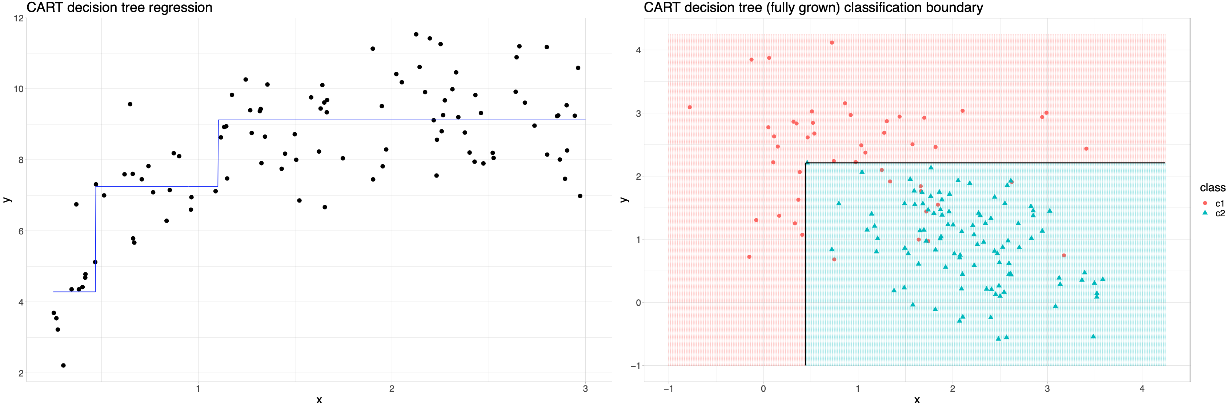
Key modelling techniques
Decision trees & random forest
Notes:
Note: this specifically describes the CART algorithm…
There are (many) other algorithms but similar principle.

Slide 51
Key modelling techniques
Decision trees & random forest
Decision trees are highly
Interpretable.
Unstable (high variance).
Random forest tries to overcome the latter at the cost of the former:
Draw B bootstrap samples.
Grow a tree for each bootstrapped dataset
Randomly select m out of p variables.
Pick best variable & split among the m variables.
Split the node.
Predict
Regression: average predicted value among the B trees
Classification: majority vote among the B trees

Slide 52
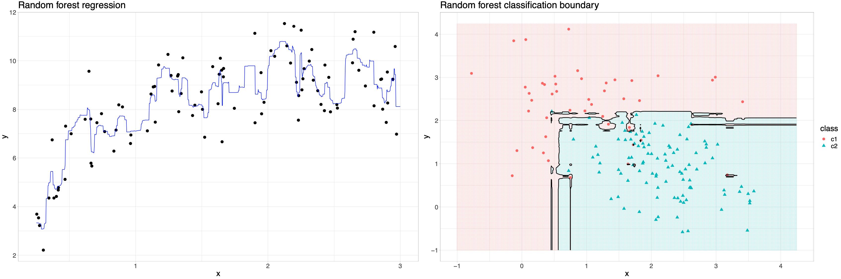
Key modelling techniques
Decision trees & random forest

Slide 53
Key modelling techniques
Mitchell, T.M. (1997), Machine Learning, McGraw-Hill
Neural networks & deep learning
Developed independently in the fields of statistics (projection pursuit) and artificial intelligence.
The basic idea is: form non-linear functions of linear combination of non-linear functions of linear combinations of …
This results in a universal approximator: for large enough numbers of nodes in the model, any continuous function can be approximated arbitrarily well.
Large class of models (focus here is on the multilayer perceptron - MLP), though for ML applications, convolutional neural networks are the standard now.
Bre et al. (2017), 10.1016/j.enbuild.2017.11.045

Slide 54
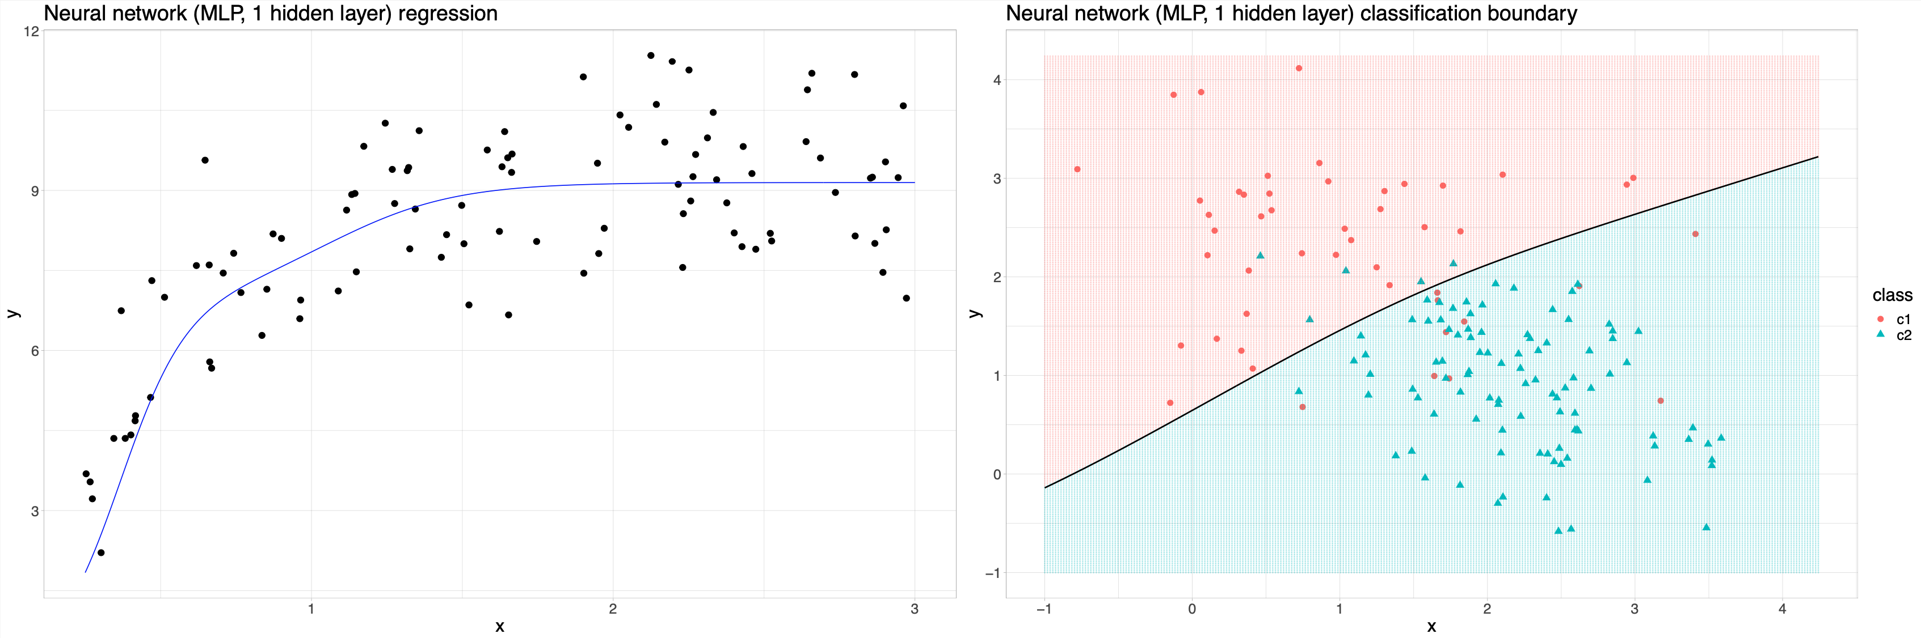
Key modelling techniques
Neural networks & deep learning

Slide 55
Key modelling techniques
Graphical models
A large class of models, that uses graphs (and graph theory) to represent the joint distribution of sets of random variables.
2 broad families:
Bayesian networks (directed acyclic graphs)
Markov graphs (undirected graphs)

Slide 56
Key modelling techniques
PCA & factor analysis
Principle component analysis is a dimensionality reduction technique.
In a set with p correlated variables, it computed a set of p linearly uncorrelated variables, ordered by decreasing amounts of variance.
Often used to obtain a lower-dimensional representation of the data, that discards noise.
The principal components are just linear combinations of the original variables (though always centre & scale first). The weights / loadings of these linear combinations are often use to describe what the PCs represent.
If this is the main aim, then factor analysis (e.g. not limited to orthogonal combinations) is likely more appropriate.

Slide 57
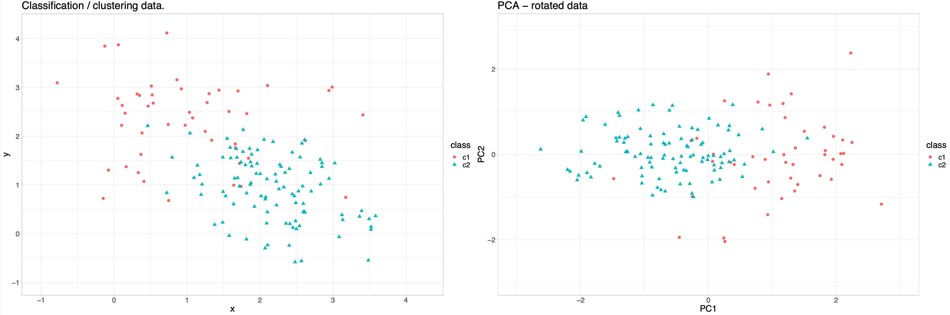
Key modelling techniques
PCA & factor analysis

Slide 58
Key modelling techniques
Bootstrap & resampling techniques
This is a set of techniques to use the data itself, to do (usually) one of 3 things:
Estimate precision of estimated parameters.
Bootstrap (draw a new set of same size from the data with replacement)
Jackknife (systematic subsets of size n-1)
Perform statistical tests via permutation.
Permutation tests (permute labels)
Assess model performance.
Cross-validation, leave-one-out (draw random subsets)
Bootstrap

Slide 59
Key modelling techniques
Many, many more!

Slide 60
Machine learning tools for statisticians

Slide 61
Resources
R
https://cran.r-project.org/
Python + NumPy, SciPy, sci-kit learn…
https://www.python.org
WEKA (multiple interfaces)
https://www.cs.waikato.ac.nz/ml/weka/
Caret (R only)
https://topepo.github.io/caret/index.html

Slide 62
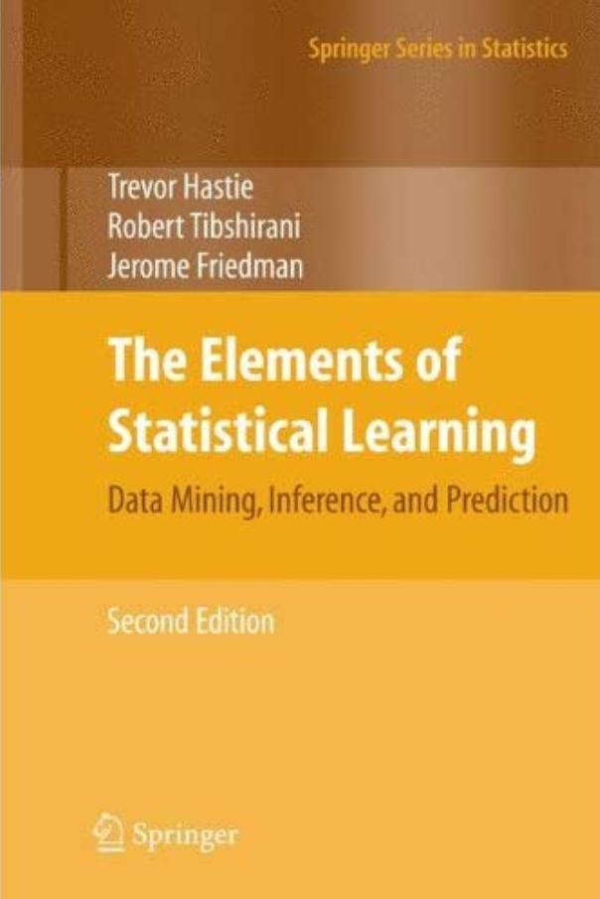
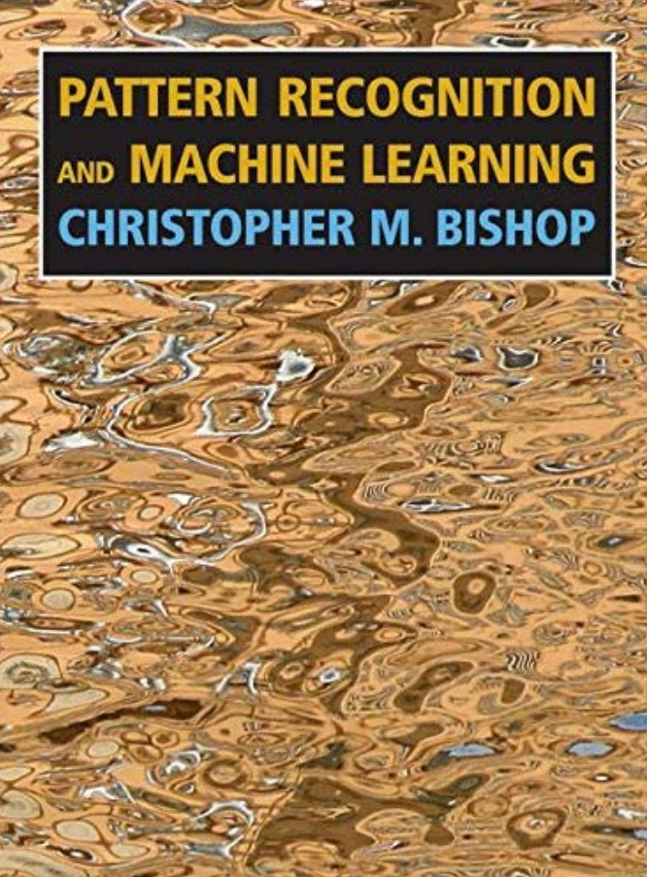
Resources

Slide 63
Resources
Slides & R code:
https://github.com/gitMarcH/IndabaX_2021

Slide 64
Thank you.

Slide 65
Shift in research model

Slide 66
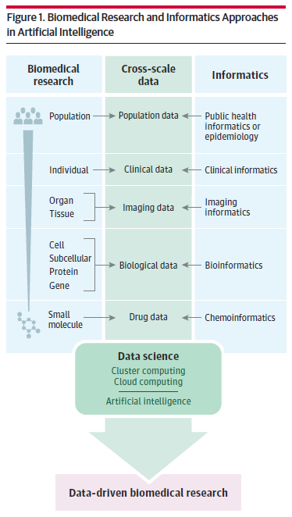
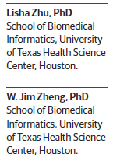
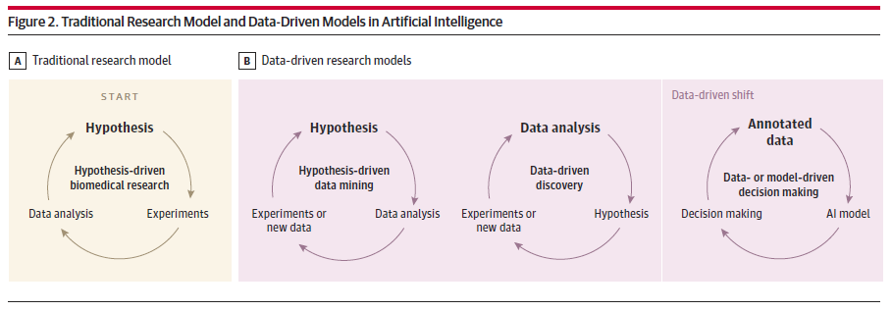
Multi-scale research & new research model

Slide 67
AI & ML in medicine
Medical research Use ML to understand biological processes or test hypotheses.
Gene network reconstruction
Drug target discovery, development, trials (e.g. REMAP designs)
…
Clinical practice Use AI to aid with clinical decision making or fine-tuning treatment.
Personalised medicine
Expert systems
Image processing
…
Health system management

